Slide 1
Fine-grained queue measurement via tapping: an experience report
Xiaoqi Chen
Department of Computer Science
Hyojoon Kim
Office of Information Technology
Princeton University

Slide 2

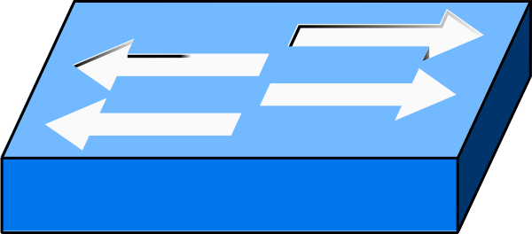

High drops, low link utilization…
Princeton campus network: 100G peering with Internet2/ESNet
“Problematic” queuing at one border switch:
  Upstream 100G to Internet2
  Downstream 8x10G to 8 servers
  High drop count on a particular port
  Link utilization always <20% at this port
What happened?
Internet2
100G
…
10G

Slide 3
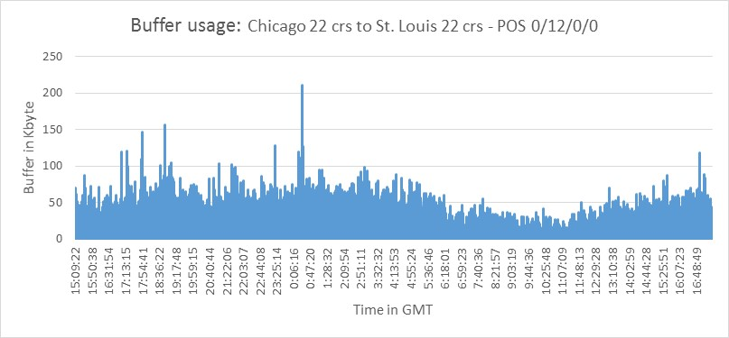
Legacy switch: lack of visibility
Current tools (e.g. SNMP) provide only 1-minute granularity
In general, legacy switches provide 1-second granularity at best
  by polling the “high watermark” (max queue length) counter
We know bursts exist, but can’t analyze the root cause
5x
3x
Queue Length
1x
16:00:00
0:00:00
8:00:00
16:00:00
Time in day (24h)

Slide 4

Offline analysis
P
Egress
Ingress
Can we tap traffic to analyze queuing,
even if links today are 100G?
Yes!
  Use a smart NIC or P4 switch
  Tap both ingress / egress port
  Calculate an invariant signature* to
  match a packet’s two appearances
  Get queuing delay
When delay is high, analyze and report
P
Ingress
P
Egress
P
Ingress
Ingress
Ingress
Packet P, flow ID F
Enqueued at t=2
Delay
8-2=6
Packet P, flow ID F
Dequeued at t=8
* See our CoNEXT’19 ConQuest paper for more detail.

Slide 5
Result: three types of high-delay events
Steady state
  One large flow
  Queue length stable
Outlier packets
  Bug, or noise?
  Slow path (control plane)?
Unstable!
  Queue oscillates wildly
  Massive drops

Slide 6

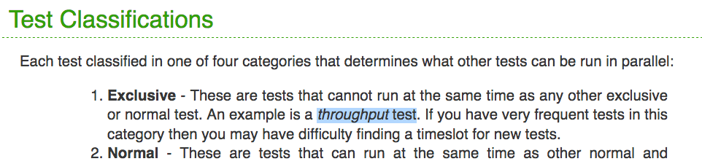
Investigation: when queue is unstable…
Source hosts are perfSonar nodes: an active measurement tool!
  Throughput tests? Latency tests?
Ongoing investigation…

Slide 7
Summary, Q&A
Scrutinizing queues in production networks is possible
Even if the legacy device does not support microseconds granularity
Tapping can be used to assist many buffer sizing experiments
  Interim solution before all switches support fine-grained queue measurement

Slide 8
Backup: Queue size CDF while unstable

