Slide 1
Understanding switch buffer utilization in CLOS data center fabric
Yihua He (hyihua@verizonmedia.com)
Nitin Batta (batta@verizonmedia.com)
Igor Gashinsky (igor@verizonmedia.com)

Slide 2
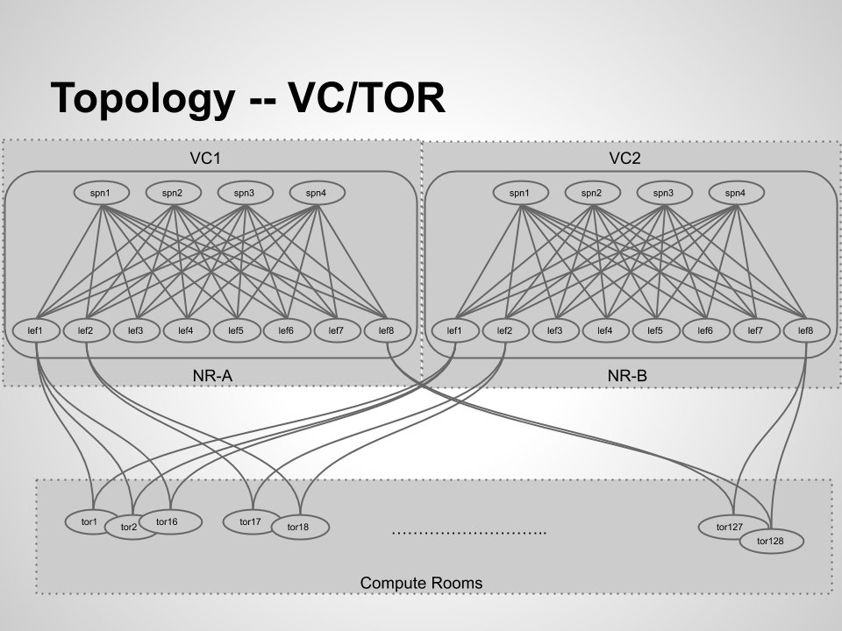
Measurement topology
SPN-LEF-TOR 3-tier CLOS
40G/10G network
Each TOR is connected with 2 LEFs, each of which in a VC
~250 TORs in the cluster, ~10000 physical hosts
16 SPNs and 32 LEFs (16 LEFs are used) per VC
Hadoop workload, a lot of east-west, incast traffic
One of the older clusters with no significant workload changes.

Slide 3
Buffer utilization for a single switch
Buffer utilization is measured by max use count (high watermark)
Each line represents a single port in the switch over time
Buffer arrangement in the measurement environment
Total buffer per switch is 12M bytes, organized as 61440 memory cells (208 bytes/cell)
A small number of reserved cells per switch
Free cells are fully share-able among any ports.
Up to cells can be allocated to a single port, where B is the total number of free cells at the time of allocation, and alpha=8

Slide 4
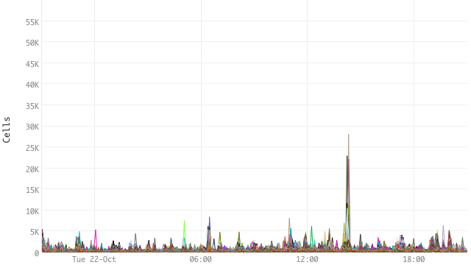
Buffer utilization in SPN switches
Measure SPN-LEF ports in all SPN switches in the cluster
There are 32x16x2=1024 SPN-LEF ports in the figure
Buffer utilization in SPN switches are low
Most ports never exceeded using more than 5k cells
A few ports reached 28k cells
Buffer ceiling is ~50k

Slide 5
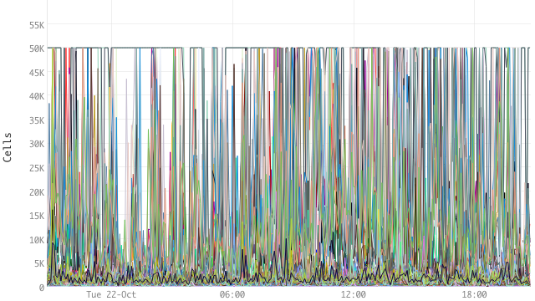
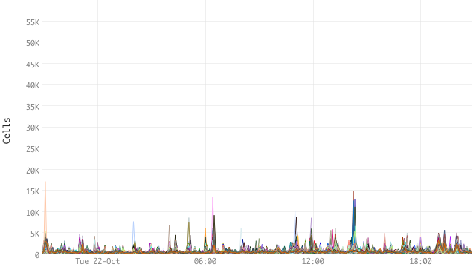
Buffer utilization in LEF switches
LEF-SPN ports
LEF-TOR ports
total 1024 LEF-SPN ports
Low utilization in buffer
total 1024 LEF-TOR ports
High utilization in buffer
Many flatlined 50k buffer ceiling

Slide 6
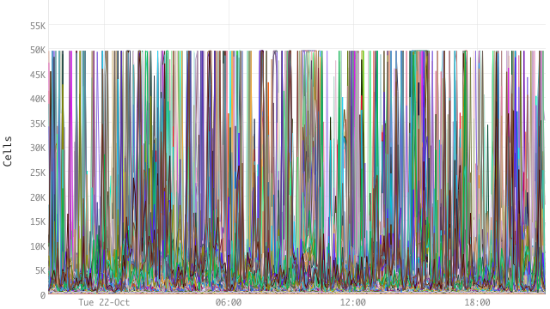
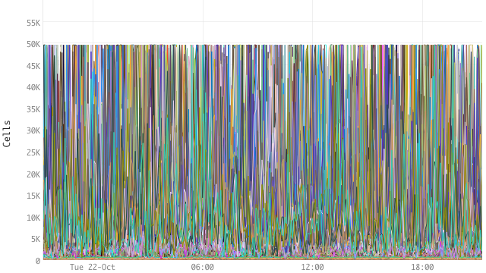
Buffer utilization in TOR switches
TOR-LEF ports
TOR-host ports
total 1024 TOR-LEF ports
High utilization in buffer
randomly picked 1024 TOR-host ports out of ~10,000 ports of the same type in the cluster
Very high utilization in buffer

Slide 7
Conclusion
Buffer utilization is not uniform within the cluster
Depends on their topological positions and type
SPN-LEF, LEF-SPN types have low buffer utilization
LEF-TOR, TOR-LEF, TOR-hosts types have high buffer utilization
Buffer by switch type: SPN:low, LEF:mid, TOR:high
Reason
Oversubscription ratio, both topological and applicational
Port speed change
Select different buffer profile switches for different topological position, and optimize cost
TD4/TH3 mix
TD3/Tofino mix

Slide 8
Future work
Measurement on newer chipsets
Quantify the relation between oversubscription ratio and buffer utilization
What’s the “sweet spot” for the available buffer?
The minimal amount buffer that doesn’t result in significant performance loss
Related to transportation protocol, congestion control
Related to oversubscription ratio, both topological and applicational
Traffic profile

