Slide 1




Who will Save the Internet from the
Congestion Control Revolution?
Ferenc Fejes, Gergő Gombos, Sándor Laki, (ELTE Eötvös Loránd University, Hungary)
Szilveszter Nádas (Ericsson Research, Hungary)

Slide 2
Background
Active Queue Management (AQM) evolution
  Usually assumes Cubic Congestion Control
Congestion Control (CC) evolution
  Usually assumes Tail Drop AQM
Buffer sizing
  Many papers are for Reno and Tail Drop
What happens
  If we mix all innovations?
  Have a heterogenous environment? (CC and RTT)

Slide 3
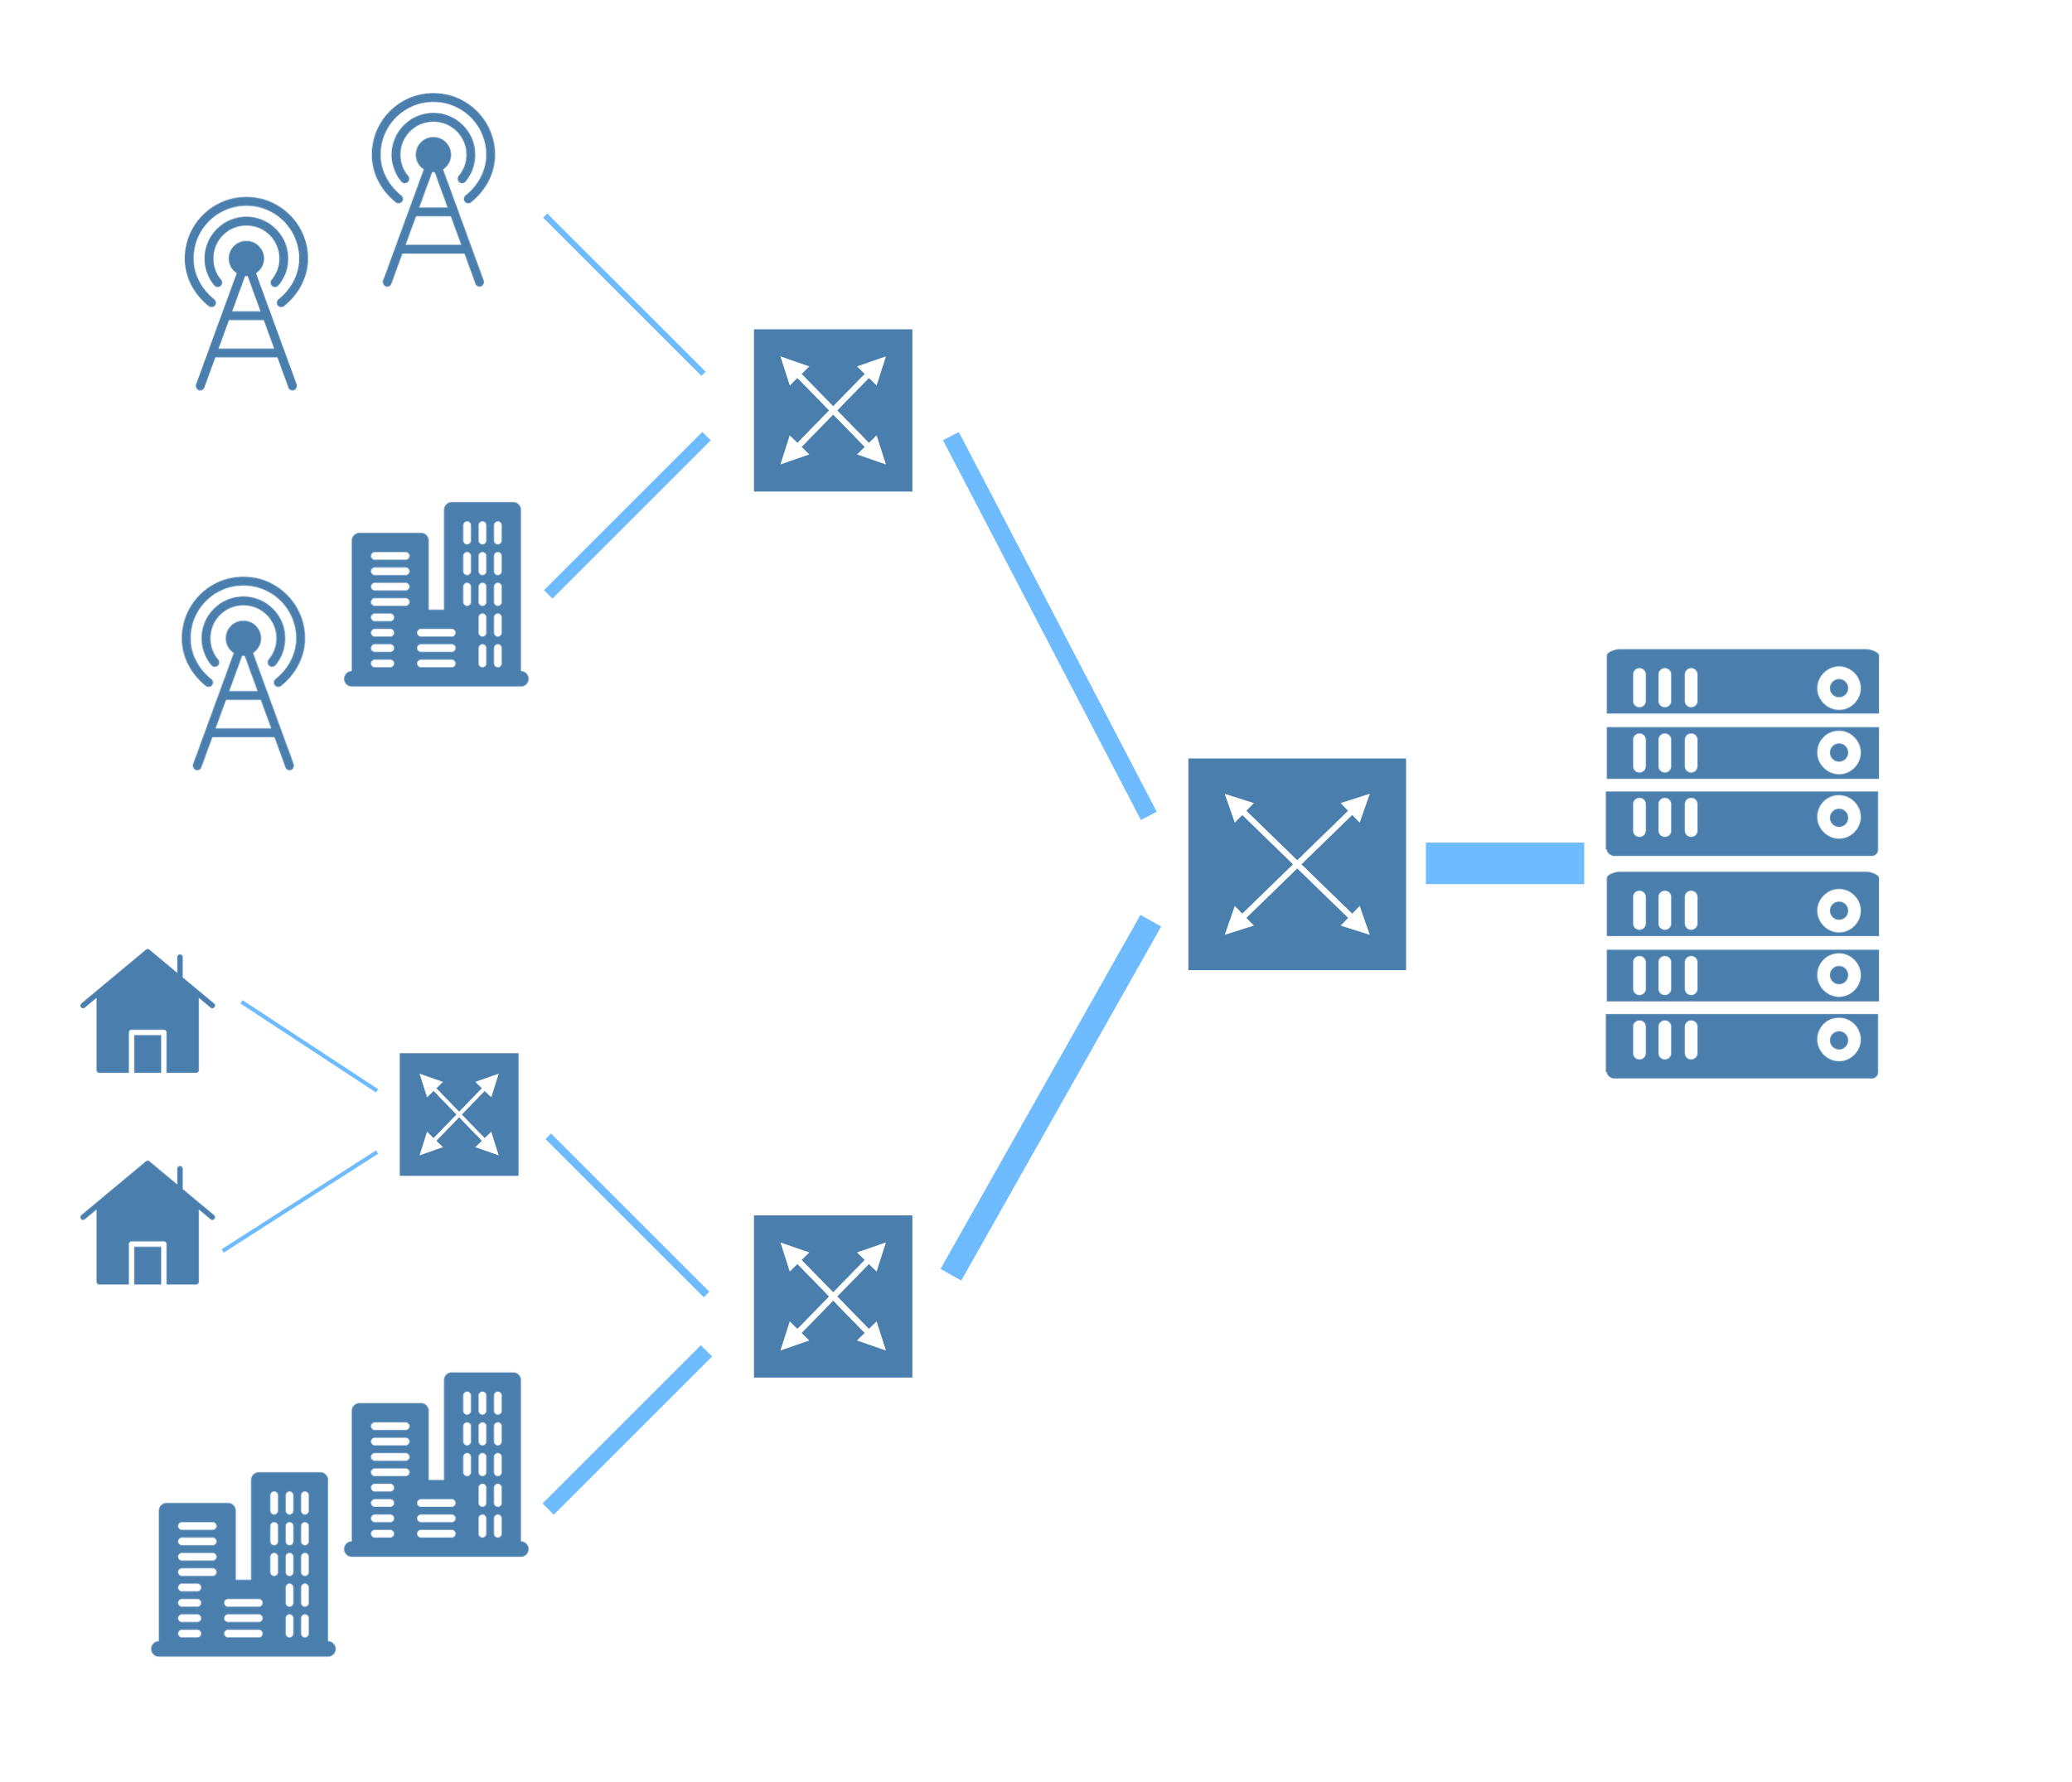
Access-Aggregation Network
Routers become bottlenecks
  Instead of last hop
  Speed of last hops have increased
    5G, Fiber To The Home
New routers, buffer size is important
  Cost of memory
  Bufferbloat
Heterogeneous traffic
  Congestion Control
  Round-Trip Time (RTT)

Slide 4
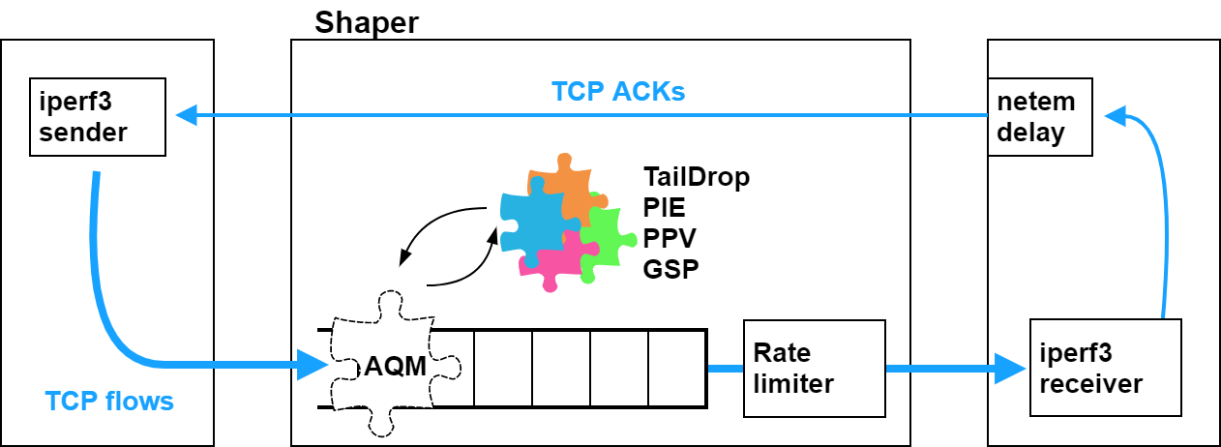

Testbed
AQMs
Implemented in DPDK
RTT emulation (of ACKs):
10ms, 100ms
CCs:
BBRv2, CUBIC
#flows:
2-100
Intel Xeon 8 core CPU (3.2GHz),
TCP traffic generated with iperf3
  Flows start at the same time
BBRv2 alpha kernel (5.2.0-rc3)
  Default settings: no pacing for Cubic, socket level pacing for BBRv2
ACKs are delayed to emulate propagation RTT (BDP)
AQMs implemented in DPDK
Buffer size:
$$α×BDP$$
Bottleneck rate:
100Mbps-1Gbps-5Gpbs
Notes:
Resource management

Slide 5
Per Packet Value based
Core-Stateless Resource Sharing Control
PPV is a Core-Stateless Resource Sharing framework, which
  allows a wide variety of detailed and flexible policies;
  enforces those policies for all traffic mixes; and
  scales well with the number of flows
Packet Marking at the edge
  traffic aggregates have to be identified
  encodes policy into a value marked on each packet
  packet header field needed
Resource Node – AQM
  behavior based on packet marking only
  no need for
    policy information
    flow identification
    separate queues
  very fast and simple implementations exist
Hard to deploy
Standardization / closed domain
AQM
Tutorial video @ ppv.elte.hu

Slide 6
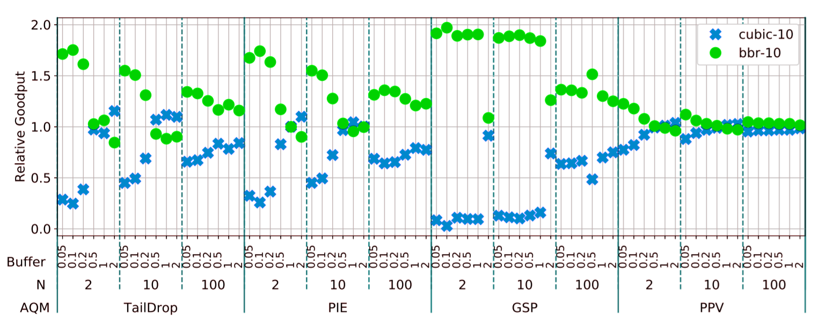
Cubic vs BBR2, 1Gbps, 10ms RTT
Notes:
Small buffers

Slide 7
Cubic vs BBR2, 1Gbps, 10ms RTT
Relative goodput of a connection class
Connection class: same RTT, same CC
Average goodput (within the connection class) / “ideal per connection fair share”
Connection classes
CC - RTT
Relative goodput “1” is the ideal (fair sharing)
Buffer size is set as factor * RTT
e.g. “0.5” means 5 ms (0.5*10ms)in this case
N: Number of connections
Half is from a connection class (N=10 → 5 Cubic + 5 BBR)
Studied AQMs
Notes:
Small buffers

Slide 8
Cubic vs BBR2, 1Gbps, 10ms RTT
Worse for Small buffers
Reasonable fairness
Good fairness
with PPV
Notes:
Small buffers

Slide 9
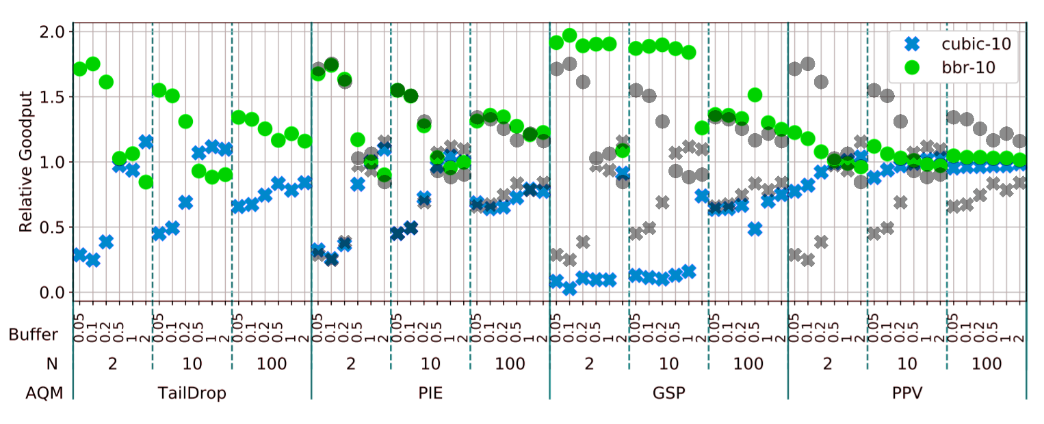
Cubic vs BBR2, 1Gbps, 10ms RTT
Similar to TailDrop
Huge degradation
(compared to TailDrop)
Like TailDrop
Gray shadow: TailDrop (for reference)
Notes:
Fair share

Slide 10
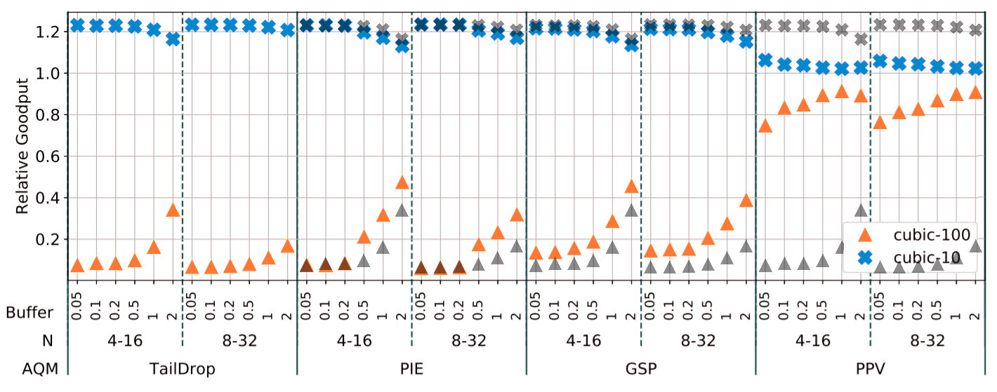
10ms vs. 100ms, Cubic, 1Gbps
(Asymmetric number of connections)
Bad fairness
100 ms conns. have low goodput
Slight improvement
Compared to TailDrop
Reasonable fairness
N: in the order of legend, e.g. 4-16 → 4*100 ms + 16*10ms connections
Buffer size as factor of the lower RTT (10 ms)
Gray shadow: TailDrop (for reference)
Notes:
Resource management

Slide 11
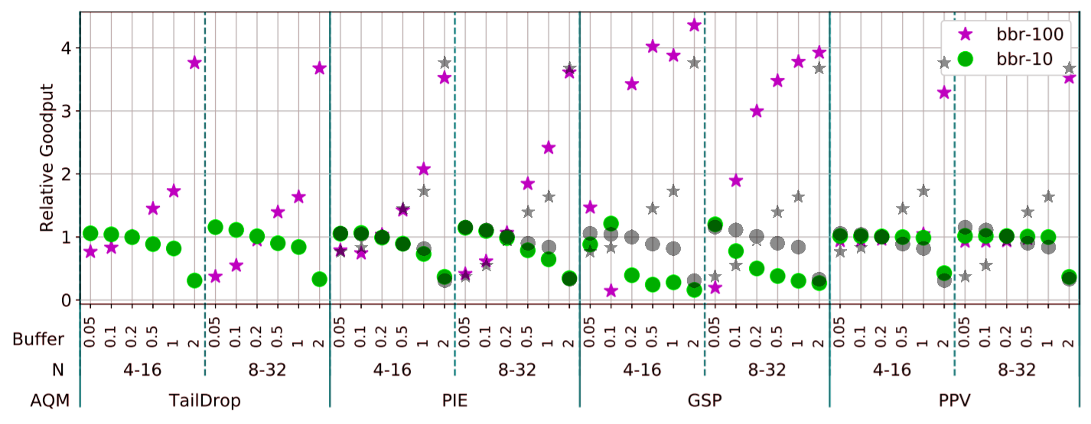
10ms vs 100ms BBR2, 1Gbps
Fairness changes with buffer length
Similar to TailDrop
Huge degradation
Favors 100 ms RTT
Reasonable fairness
Except 20 ms buffer
Gray shadow: TailDrop (for reference)
Notes:
Resource management

Slide 12
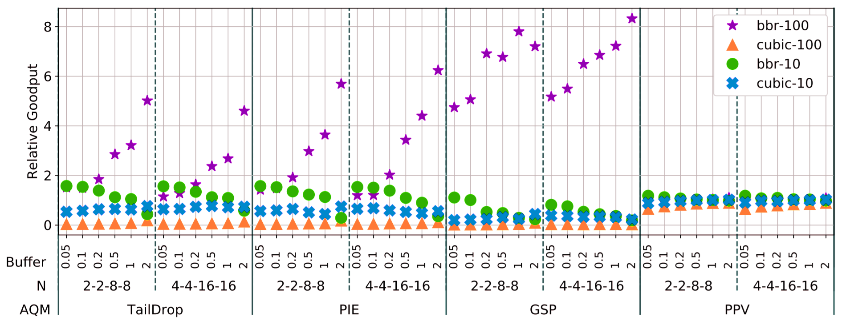
Cubic vs BBR2 + mixed RTT
BBR with 100 ms RTT dominates
Even more with PIE and GSP than with TailDrop
Reasonable fairness with PPV
Zoomed on next slide
Notes:
Resource management

Slide 13
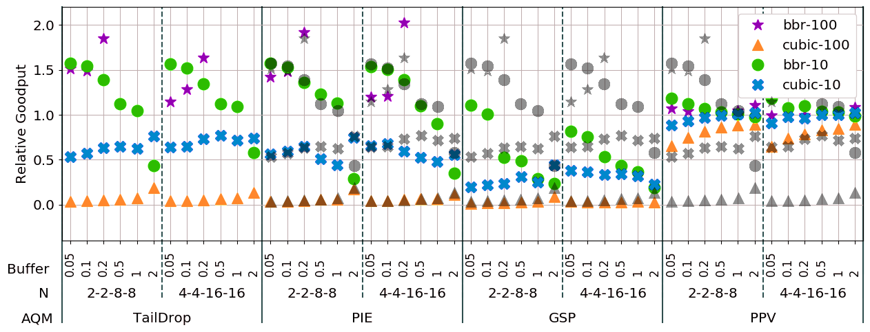
Cubic vs BBR2 mixed RTT (zoomed region 0-2)
BBR with 100 ms RTT dominates
Even more with PIE and GSP than with TailDrop
Further decrease in Cubic goodput (both 10 ms and 100 ms)
Very small goodput for Cubic with 100 ms RT
Gray shadow: TailDrop (for reference)
Notes:
Resource management

Slide 14
Experimental Analysis: Findings
High utilization in general, except for very small buffers (0.05-0.1 BDP) and small N
AQM with Control of Resource Sharing (PPV) provides reasonable fairness in all cases
Mono-CC fairness is good in most cases
  All except Mono-BBR with GSP

Slide 15
Experimental Analysis: Findings (2)
Cubic vs. BBR fairness is very dependent on settings
  Depends on (common) RTT and bottleneck capacity (100ms, 1 Gbps was the worst case)
  Depends on Buffer Size for TailDrop (this was the design target for BBRv2 Cubic compatibility)
  PIE and GSP usually do not help or hurt fairness
Heterogenous RRTs (10 ms vs. 100 ms)
  PIE and GSP
    Improve fairness for mono-Cubic
    They decrease fairness in mono-BBR and mixed CC cases
  Mono-BBR fairness is interesting
    Higher share for low RTT flows for small buffers, for high RTT flows for longer buffers
    Different optimum (mid-sized buffer) than for Cubic (large buffer)

Slide 16
Summary
Modern AQMs (PIE, GSP) are not prepared for modern Congestion Controls, and for CC coexistence
  It might be possible to design simple AQM for well defined scenarios,
  It is very hard to design for evolution
AQM with Control of Resource Sharing(PPV) provides reasonable fairness in all cases
  But there are deployment issues
Choosing the right AQM and investigating a realistic CC and RTT mix is very important
  Often higher impact than the size of the buffer itself
  In some cases, fairness is very bad (i.e. starvation) in the heterogeneous scenarios
More results, more details
  Visit our poster
  In the article
  All measurement results in [7] (a zip file with many graphs - http://ppv.elte.hu/buffer-sizing/ )

